Slide 1
CHAPTER - X DATA STRUCTURES II

Slide 2
INTRODUCTION
What is Data Structure?
In computer science, a data structure is a particular way of organizing data in a computer so that it can be used
Data structures provide a means to manage large amounts of data efficiently for uses such as large databases and internet indexing services. Usually, efficient data structures are key to designing efficient algorithms.

Slide 3
Important methods and functions of List
Function | Description
list.append() | Add an Item at end of a list
list.extend() | Add multiple Items at end of a list
list.insert() | insert an Item at a defined index
list.remove() | remove an Item from a list
del list[index] | Delete an Item from a list
list.clear() | empty all the list
list.pop() | Remove an Item at a defined index
list.index() | Return index of first matched item
list.sort() | Sort the items of a list in ascending or descending order
list.reverse() | Reverse the items of a list
len(list) | Return total length of the list.
max(list) | Return item with maximum value in the list.
min(list) | Return item with min value in the list.
list(seq) | Converts a tuple, string, set, dictionary into list.

Slide 4
STACKS

Slide 5
STACKS
What is STACK?
In computer science, a stack is a last in, first out (LIFO) data structure. A stack is dynamic data structure as it can grow or shrink. A static data structure is the one that has fixed size.

Slide 6
STACK OPERATIONS
67
89
67
TOP
TOP
TOP=NONE
PUSH 67
PUSH 89

Slide 7
STACK OPERATIONS
89
67
67
89
TOP
TOP
PUSH 89

Slide 8
STACK TERMINOLOGIES

Slide 9
STACK TERMINOLOGIES
The following are the terms which are frequently used to denote some kind of operation in stack.
The PUSH operation adds an item to the top of the stack.
The POP operation removes an item from the top of the stack.
1. PUSH
2. POP

Slide 10
STACK TERMINOLOGIES
The following are the terms which are frequently used to denote some kind of operation in stack.
It is also called as inspection, refers to inspecting the value at the stack.
Its an Error, when some one tries to push an item in stack that is full.
3. PEEK
4. OVER FLOW

Slide 11
STACK TERMINOLOGIES
.
Its an Error, when some one tries to pop or delete an item from an empty stack.
5. UNDER FLOW

Slide 12
STACK PROGRAM

Slide 13
APPLICATIONS OF STACKS

Slide 14
APPLICATIONS OF STACKS
1. EXPRESSION EVALUATION
2. EXPRESSION CONVERSION
3. SYNTAX PARSING
4. BACKTRACKING
Continued….

Slide 15
APPLICATIONS OF STACKS
5. PARENTHESIS CHECKING
6. STRING REVERSAL
7. FUNCTION CALL

Slide 16
APPLICATIONS OF STACKS
1. EXPRESSION EVALUATION
Stack is used to evaluate prefix, postfix and infix expressions. (infix, Prefix and postfix expressions you will study in next topic.)

Slide 17
APPLICATIONS OF STACKS
2. EXPRESSION CONVERSION
An expression can be represented in prefix, postfix or infix notation.
Stack can be used to convert one form of expression to another.

Slide 18
APPLICATIONS OF STACKS
3. SYNTAX PARSING
Many compilers use a stack for parsing the syntax of expressions, program blocks etc. before translating into low level code.
What is parsing?
A parser is a compiler or interpreter component that breaks data into smaller elements for easy translation into another language.

Slide 19
APPLICATIONS OF STACKS
4. BACKTRACKING
Suppose we are finding a path for solving maze problem. We choose a path and after following it we realize that it is wrong. Now we need to go back to the beginning of the path to start with new path. This can be done with the help of stack.

Slide 20
APPLICATIONS OF STACKS
4. BACKTRACKING
What is Maze problem?
A maze is a path or collection of paths, typically from an entrance to a goal.
OR
Find the total number of unique paths which the robot can take in a given maze to reach the destination from given source.

Slide 21
APPLICATIONS OF STACKS
4. BACKTRACKING
The Problem
A robot is asked to navigate a maze. It is placed at a certain position (the starting position) in the maze and is asked to try to reach another position (the goal position). Positions in the maze will either be open or blocked with an obstacle. Positions are identified by (x,y) coordinates.

Slide 22
APPLICATIONS OF STACKS
4. BACKTRACKING
The Problem
A robot is asked to navigate a maze. It is placed at a certain position (the starting position) in the maze and is asked to try to reach another position (the goal position). Positions in the maze will either be open or blocked with an obstacle. Positions are identified by (x,y) coordinates.

Slide 23
APPLICATIONS OF STACKS
5. PARENTHESIS CHECKING
Stack is used to check the proper opening and closing of parenthesis.
6. STRING REVERSAL
Stack is used to reverse a string. We push the characters of string one by one into stack and then pop character from stack.

Slide 24
APPLICATIONS OF STACKS
7. FUNCTION CALL
Stack is used to keep information about the active functions or subroutines..

Slide 25
DIFFERENT ALGEBRAIC EXPRESSIONS

Slide 26
DIFFERENT ALGEBRAIC EXPRESSIONS
INFIX EXPRESSION | POSTFIX EXPRESSION
(P+Q)*(M-N) | PQ+MN-*
(P+Q) / (M-N) - (A*B) | PQ+MN-/AB*-

Slide 27
EXPRESSION CONVERSION METHOD

Slide 28
EXPRESSION CONVERSION METHOD
Converting from Infix to Postfix
Infix expressions can be easily converted by hand to postfix notation.
The expression :
A + B - C
would be written as AB+C- in postfix form

Slide 29
EXPRESSION CONVERSION METHOD
Converting from Infix to Postfix
STEP 1
A*B+C/D
Place parentheses around every group of operators in the correct order of evaluation. There should be one set of parentheses for every operator in the infix expression.
((A * B) + (C / D))

Slide 30
Converting from Infix to Postfix
STEP 2
For each set of parentheses, move the operator from the middle to the end preceding the corresponding closing parenthesis. ((A B *) (C D /) +)

Slide 31
Converting from Infix to Postfix
STEP 3
3. Remove all of the parentheses, resulting in the equivalent postfix expression.
A B * C D / +

Slide 32
CONVERSION METHOD

Slide 33
CONVERSION – Example 1
For example convert the infix expression
(A+B)*(C-D)/E
into postfix expression showing stack status after every step.

Slide 34
Symbol scanned | Stack status | Postfix expr
 | (
( | ((
A | (( | A
+ | ((+ | A
B | ((+ | AB
) | (
* | (*
( | (*(
C | (*( | AB+C
- | (*(- | AB+C
D | (*(- | AB+CD
) | (* | AB+CD-
/ | (/ | AB+CD-*
E | (/ | AB+CD-*E
) |  | AB+CD-*E/
Answer : AB+CD-*E/

Slide 35
EVALUATION – Example 2
Evaluate the following postfix expression showing stack status after every step
8, 2, +, 5, 3, -, *, 4 /

Slide 36
EVALUATION – Example 2
8, 2, +, 5, 3, -, *, 4 /
scanned | Stack status | Operation performed
8 | 8 | Push 8
2 | 8, 2 | Push 2
+ | 10 | Op2=pop() i.e 2 Op1=pop() i.e 8 Push(op1+op2) i.e. 8+2
5 | 10, 5 | Push(5)
3 | 10, 5, 3 | Push(3)
- | 10, 2 | Op2=pop() i.e. 3 Op1=pop() i.e. 5 Push(op1-op2) i.e. 5-3

Slide 37
EVALUATION – Example 2
8, 2, +, 5, 3, -, *, 4 /
scanned | Stack status | Operation performed
* | 20 | Op2=pop() i.e. 2 Op1=pop() i.e. 10 Push(op1-op2) i.e. 10*2
4 | 20, 4 | Push 4
/ | 5 | Op2=pop() i.e. 4 Op1=pop() i.e. 20 Push(op1/op2) i.e. 20/4
NULL | Final result 5 | Pop 5 and return 5
Answer : 5

Slide 38
EVALUATION – Example 3
Evaluate the following Boolean postfix expression showing stack status after every step.
True, False, True, AND, OR, False, NOT, AND

Slide 39
EVALUATION – Example 3
True, False, True, AND, OR, False, NOT, AND
scanned | Stack status | Operation performed
True | True | Push True
False | True, False | Push False
True | True, False, True | Push True
AND | True, False | Op2=pop() i.e. True Op1=pop() i.e. False Push(Op2 AND Op1) i.e. False AND True=False
OR | True | Op2=pop() i.e. False Op1=pop() i.e. True Push(Op2 OR Op1) i.e. True OR False=True

Slide 40
EVALUATION – Example 3
True, False, True, AND, OR, False, NOT, AND
Scanned | Stack status | Operation Performed
False | True, False | Push False
NOT | True, True | Op1=pop() i.e. False Push(NOT False) i.e. NOT False=True
AND | True | Op2=pop() i.e. True Op1=pop() i.e. True Push(Op2 AND Op1) i.e. True AND True=True
NULL | Final result True | Pop True and Return True
Answer :True

Slide 41
EXPRESSION TRANSLATION
CLASSWORK/HOME WORK
INFIX EXPRESSIONS INTO POSTFIX
Translate each of the following infix expressions into postfix.
(A * B) / C
(A - (B * C) + D / E
(X - Y) + (W * Z) / V
V * W * X + Y - Z
A / B * C - D + E

Slide 42
QUEUE

Slide 43
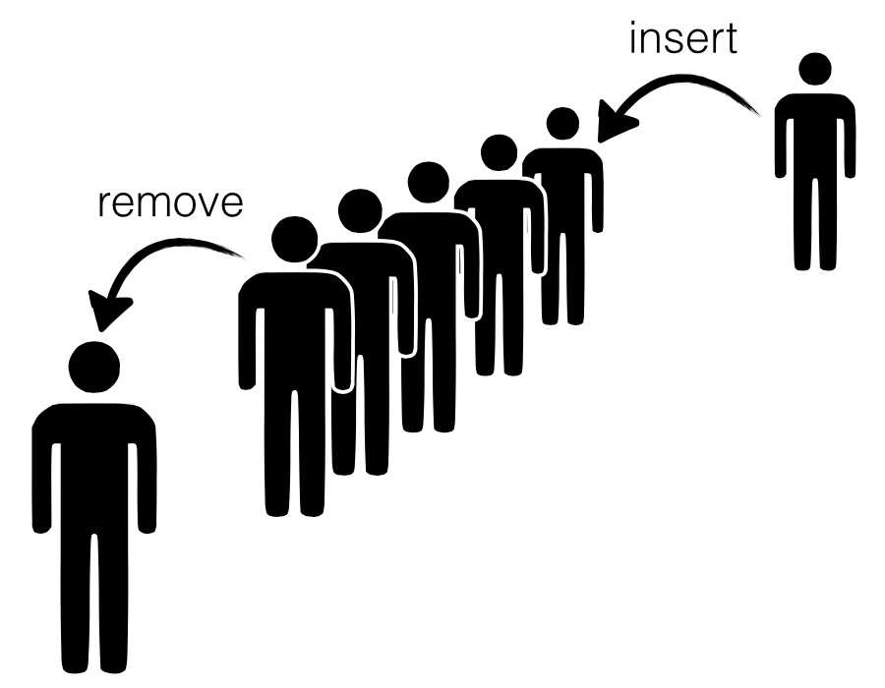
QUEUE
What is Queue?
Queue is a linear data structure which follows First In First Out (FIFO) rule in which a new item is added at the rear end and deletion of item is from the front end of the queue. In a FIFO data structure, the first element added to the queue will be the first one to be removed.

Slide 44
QUEUE TERMINOLOGIES

Slide 45
QUEUE TERMINOLOGIES
The following are the terms which are frequently used to denote some kind of operation in queue.
The add or append or pushing operation in queue, adds an item to the REAR of the queue.
The deleting or popping operation, removes an item from the front end of queue.
1. ENQUEUE
2. DEQUEUE

Slide 46
QUEUE TERMINOLOGIES
The following are the terms which are frequently used to denote some kind of operation in stack.
It is also called as inspection, refers to inspecting the value at the queue.
Its an Error, when some one tries to push an item in queue that is full.
3. PEEK
4. OVER FLOW

Slide 47
QUEUE TERMINOLOGIES
5. UNDER FLOW
Its an Error, when some one tries to pop or delete an item from an empty queue.

Slide 48
DIAGRAMATIC REPRESENTATION OF QUEUE

Slide 49
DIAGRAMATIC REPRESENTATION OF QUEUE
0
1
2
3
4
Now, QUEUE is Empty so,
FRONT = REAR = None
UNDERFLOW
FRONT = REAR = None, so if you try to delete or dequeue, underflow occurs, since no element to delete

Slide 50
DIAGRAMATIC REPRESENTATION OF QUEUE
ENQUEUE
Now, ENQUEUE with 56, then
FRONT = REAR = 0
0
1
2
3
4
FRONT
56
REAR

Slide 51
DIAGRAMATIC REPRESENTATION OF QUEUE
ENQUEUE
Now, ENQUEUE with 783, then
FRONT = 0 and REAR = 1
0
1
2
3
4
FRONT
56 | 783
REAR

Slide 52
DIAGRAMATIC REPRESENTATION OF QUEUE
ENQUEUE
Now, ENQUEUE with 126, then
FRONT = 0 and REAR = 2
0
1
2
3
4
FRONT
56 | 783 | 126
REAR

Slide 53
DIAGRAMATIC REPRESENTATION OF QUEUE
DEQUEUE
Now, DEQUEUE, then
FRONT = 1 and REAR = 2
0
1
2
3
4
 | 783 | 126
FRONT
REAR

Slide 54
DIAGRAMATIC REPRESENTATION OF QUEUE
ENQUEUE
Now, ENQUEUE with 654, then
FRONT = 1 and REAR = 3
0
1
2
3
4
 | 783 | 126 | 654
FRONT
REAR

Slide 55
DIAGRAMATIC REPRESENTATION OF QUEUE
ENQUEUE
Now, ENQUEUE with 914, then
FRONT = 1 and REAR = 4
0
1
2
3
4
 | 783 | 126 | 654 | 914
FRONT
REAR

Slide 56
DIAGRAMATIC REPRESENTATION OF QUEUE
ENQUEUE
OVERFLOW
Now, ENQUEUE with 637, then
OVERFLOW occurs since no space to insert in queue.
0
1
2
3
4
 | 783 | 126 | 654 | 914
FRONT
REAR

Slide 57
SIZE OF QUEUE

Slide 58
SIZE OF QUEUE
Size of queue or Total number of elements can be determined by the following formula:
No of Elements = REAR – FRONT + 1

Slide 59
APPLICATIONS OF QUEUES

Slide 60
APPLICATIONS OF QUEUES
1. Serving requests on a single shared resource, like a printer.
2. CPU task scheduling.
3. In real life scenario, Call Center phone systems uses Queues to hold people calling them in an order, until a service representative is free.

Slide 61
APPLICATIONS OF QUEUES
4.When data is transferred asynchronously between two processes. eg. IO Buffers.
5.When a resource is shared among multiple consumers. Examples include CPU scheduling, Disk Scheduling.
6.In recognizing palindrome.

Slide 62
APPLICATIONS OF QUEUES
7.In shared resources management.
8.Keyboard buffer.
9.Round robin scheduling.
10.Job scheduling.
11.Simulation

Slide 63
TYPES OF QUEUES

Slide 64
TYPES OF QUEUES
Queue is an important structure for storing and retrieving data and hence is used extensively among all the data structures. Types of Queues are:-
1. SIMPLE QUEUE
2. CIRCULAR QUEUE
3. PRIORITY QUEUE
4. DOUBLY ENDED QUEUE (DEQUEUE)

Slide 65
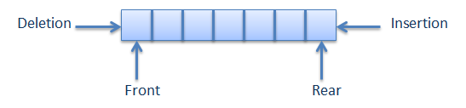
TYPES OF QUEUES
1. SIMPLE QUEUE
As studied in previous topic.

Slide 66
TYPES OF QUEUES
2. CIRCULAR QUEUE
Unlike the simple queues, in a circular queue each node is connected to the next node in sequence but the last node’s pointer is also connected to the first node’s address. Hence, the last node and the first node also gets connected making a circular link overall.

Slide 67
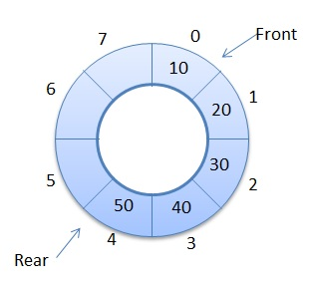
TYPES OF QUEUES
2. CIRCULAR QUEUE

Slide 68
Thank You

